Slide 1
INTERNET AND WEB TECHNOLOGY LAB
ABHAY RAIZADA(13/IT/68)
SHAUNAK SEN(13/IT/82)
SURYA PRAKASH(13/IT/74)

Slide 2
AIM: To Create Admin and Student Login Project
We wish to create an admin-student login for the purpose of grade and attendance upload and view.
Till now we’ve created a Basic Landing Page for the purpose of registration of the student or admin.
Technologies Used: So far we’ve used basic HTML and CSS

Slide 3
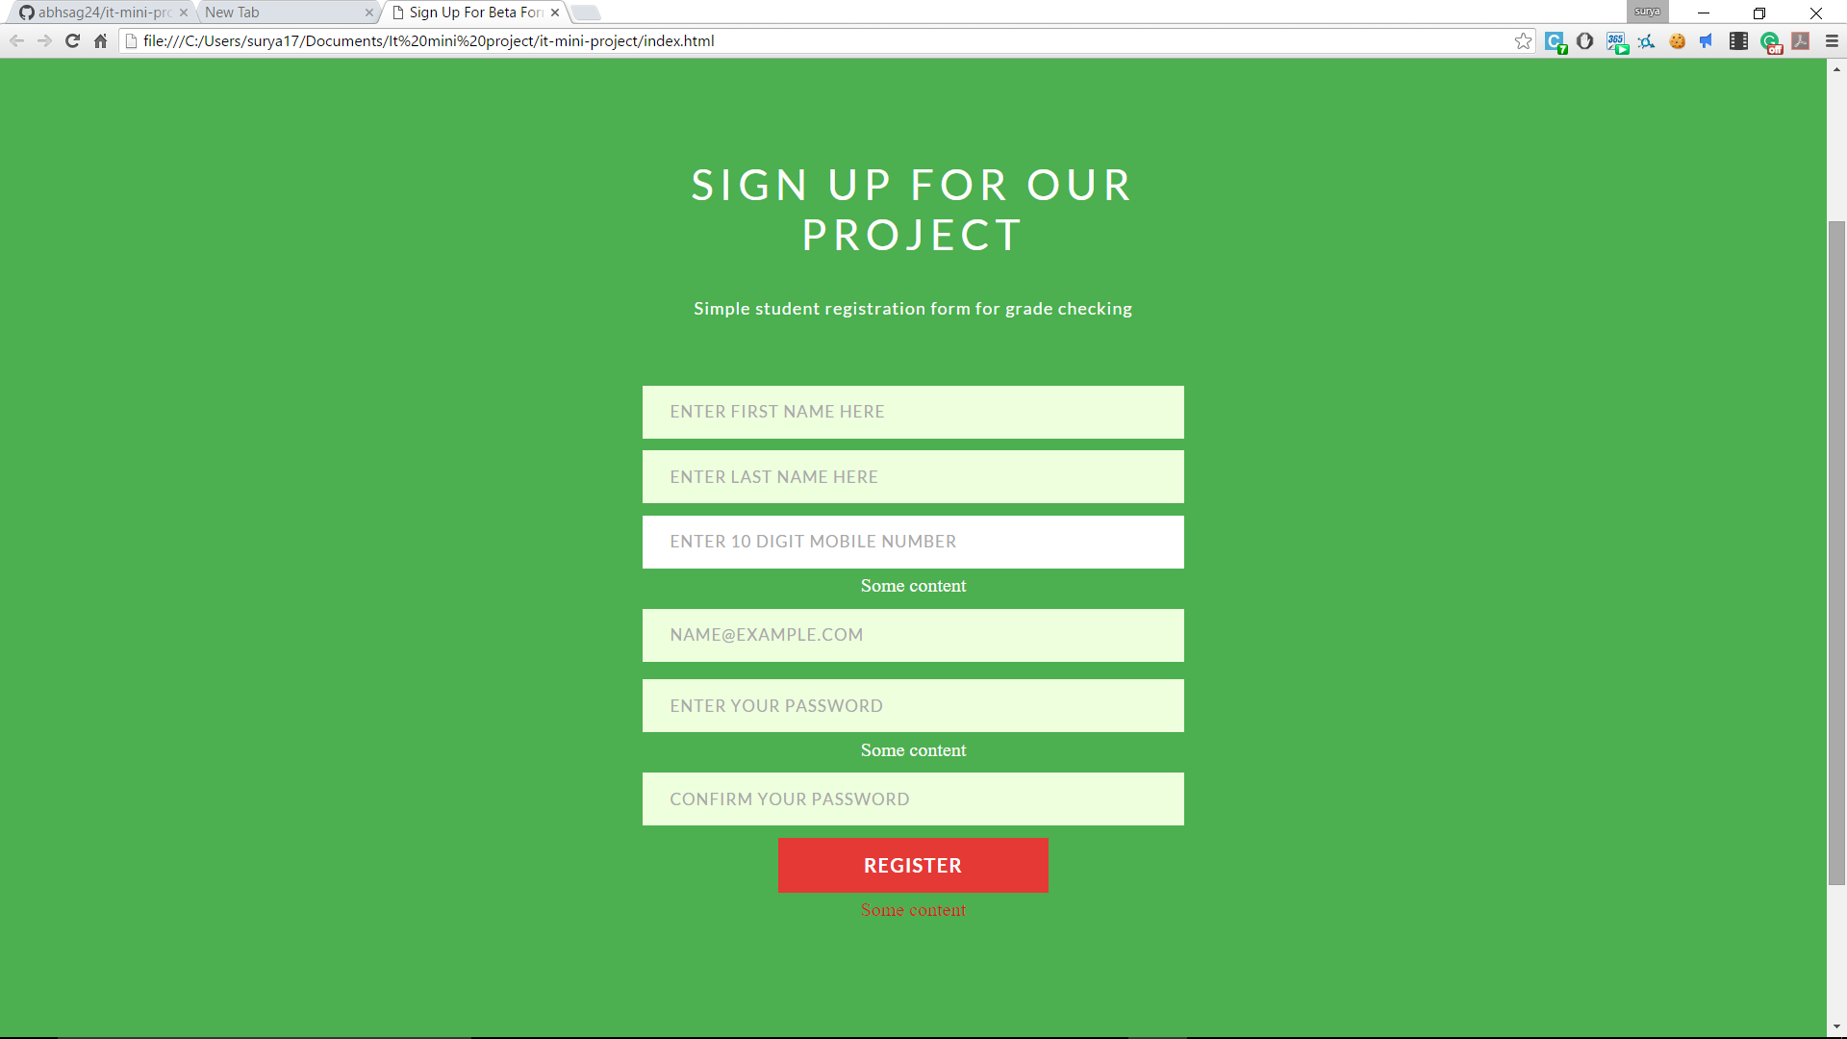
This is the screenshot of the landing page

Slide 4
In the previous slide we have shown the webpage which has fields that are required for registration.
We wish to create a portal where professors can upload and modify the grades and attendance of students and the latter can just check their details by logging in.
Details of this project can be found at https://github.com/abhsag24/it-mini-project

